Slide 1
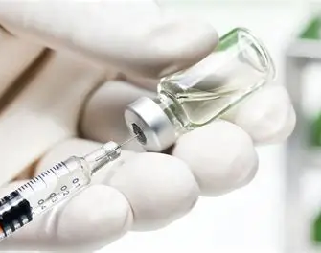
H1N1 Vaccine uptake prediction: The 2019 H1N1 Flu and Seasonal Flu survey
Ronoh Collins
ronohcollins@gmail.com

Slide 2
Overview
The project analyses the H1N1 vaccine uptake from the 2019 survey provided by the United States National Center for Health Statistics.
The aim of the study is:
Build an accurate H1N1 vaccination prediction model
Determine demographic, behavioral and health related factors influencing H1N1 vaccination status

Slide 3
Data
The data is composed of:
26708 respondents
35 unique features/factors
78.76% of the respondents did not get vaccinated
Data source- United states National Flu Survey(NHFS,2009)

Slide 4
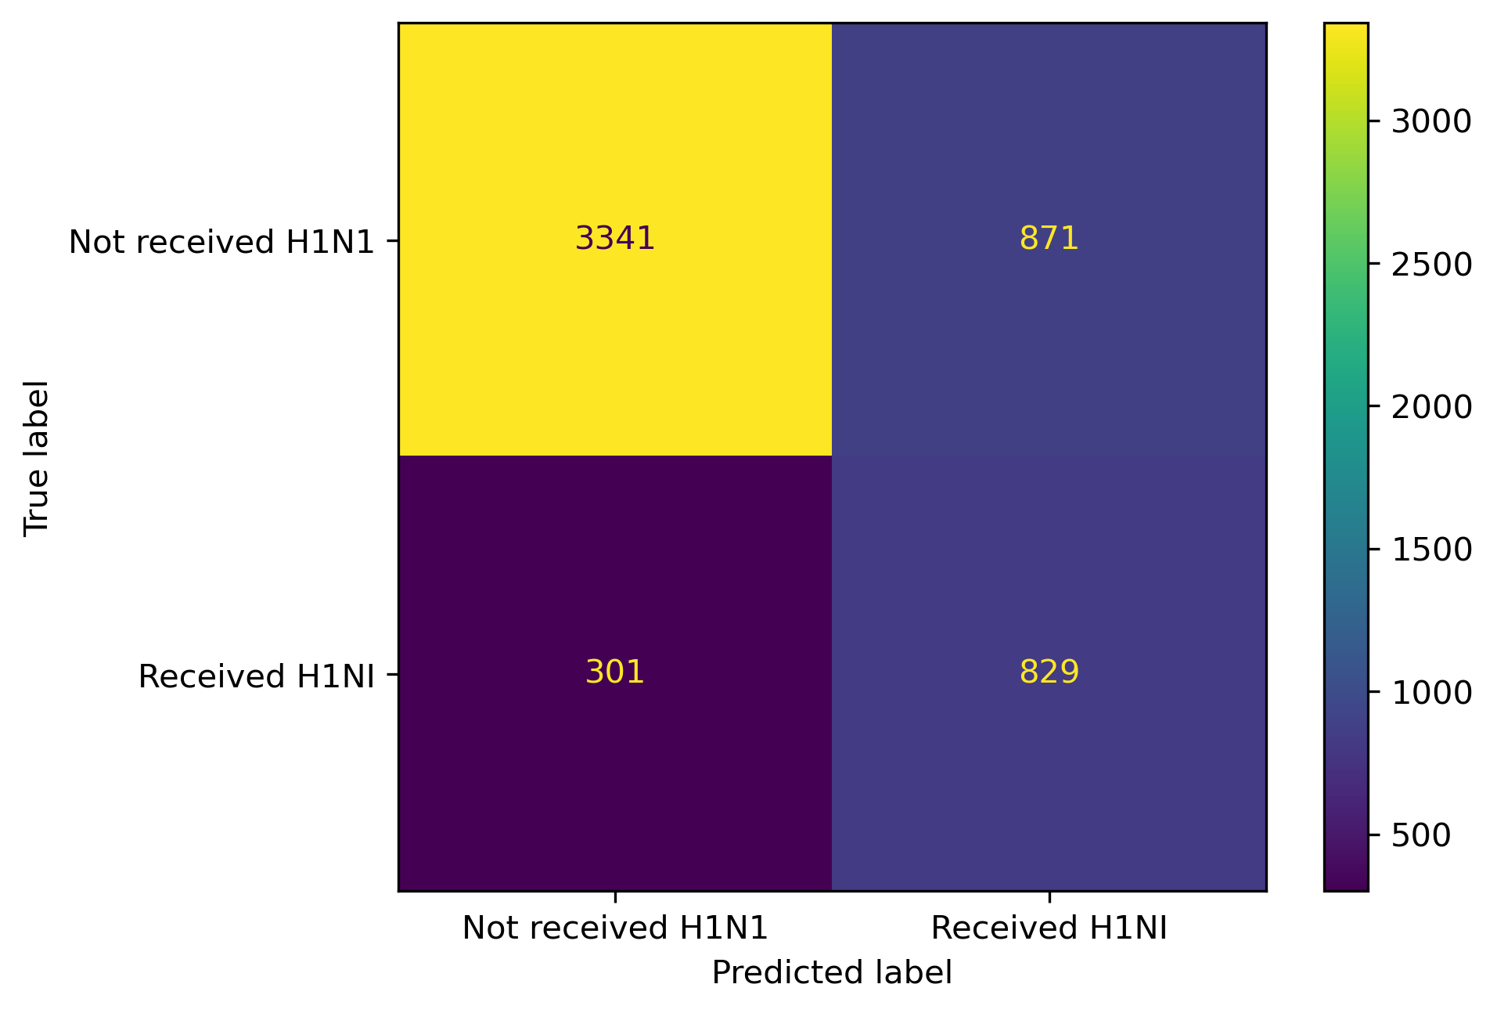
Modelling
CONTEXT:
False Positive: Predicting that People did get vaccine when they actually did not => BIG PROBLEM
False Negative: Predicting that people did not get vaccine when they actually did get=> NOT A BIG PROBLEM

Slide 5
Classification Report
 | precision | recall | f1-score | support
0 | 0.917353 | 0.79321 | 0.850777 | 4212
1 | 0.487647 | 0.733628 | 0.585866 | 1130
accuracy | 0.780607 | 0.780607 | 0.780607 | 0.780607
macro avg | 0.7025 | 0.763419 | 0.718321 | 5342
weighted avg | 0.826457 | 0.780607 | 0.79474 | 5342
Recall =73.36%
Precision = 48.76%
Accuracy =78%
F1-Score =58.58%

Slide 6
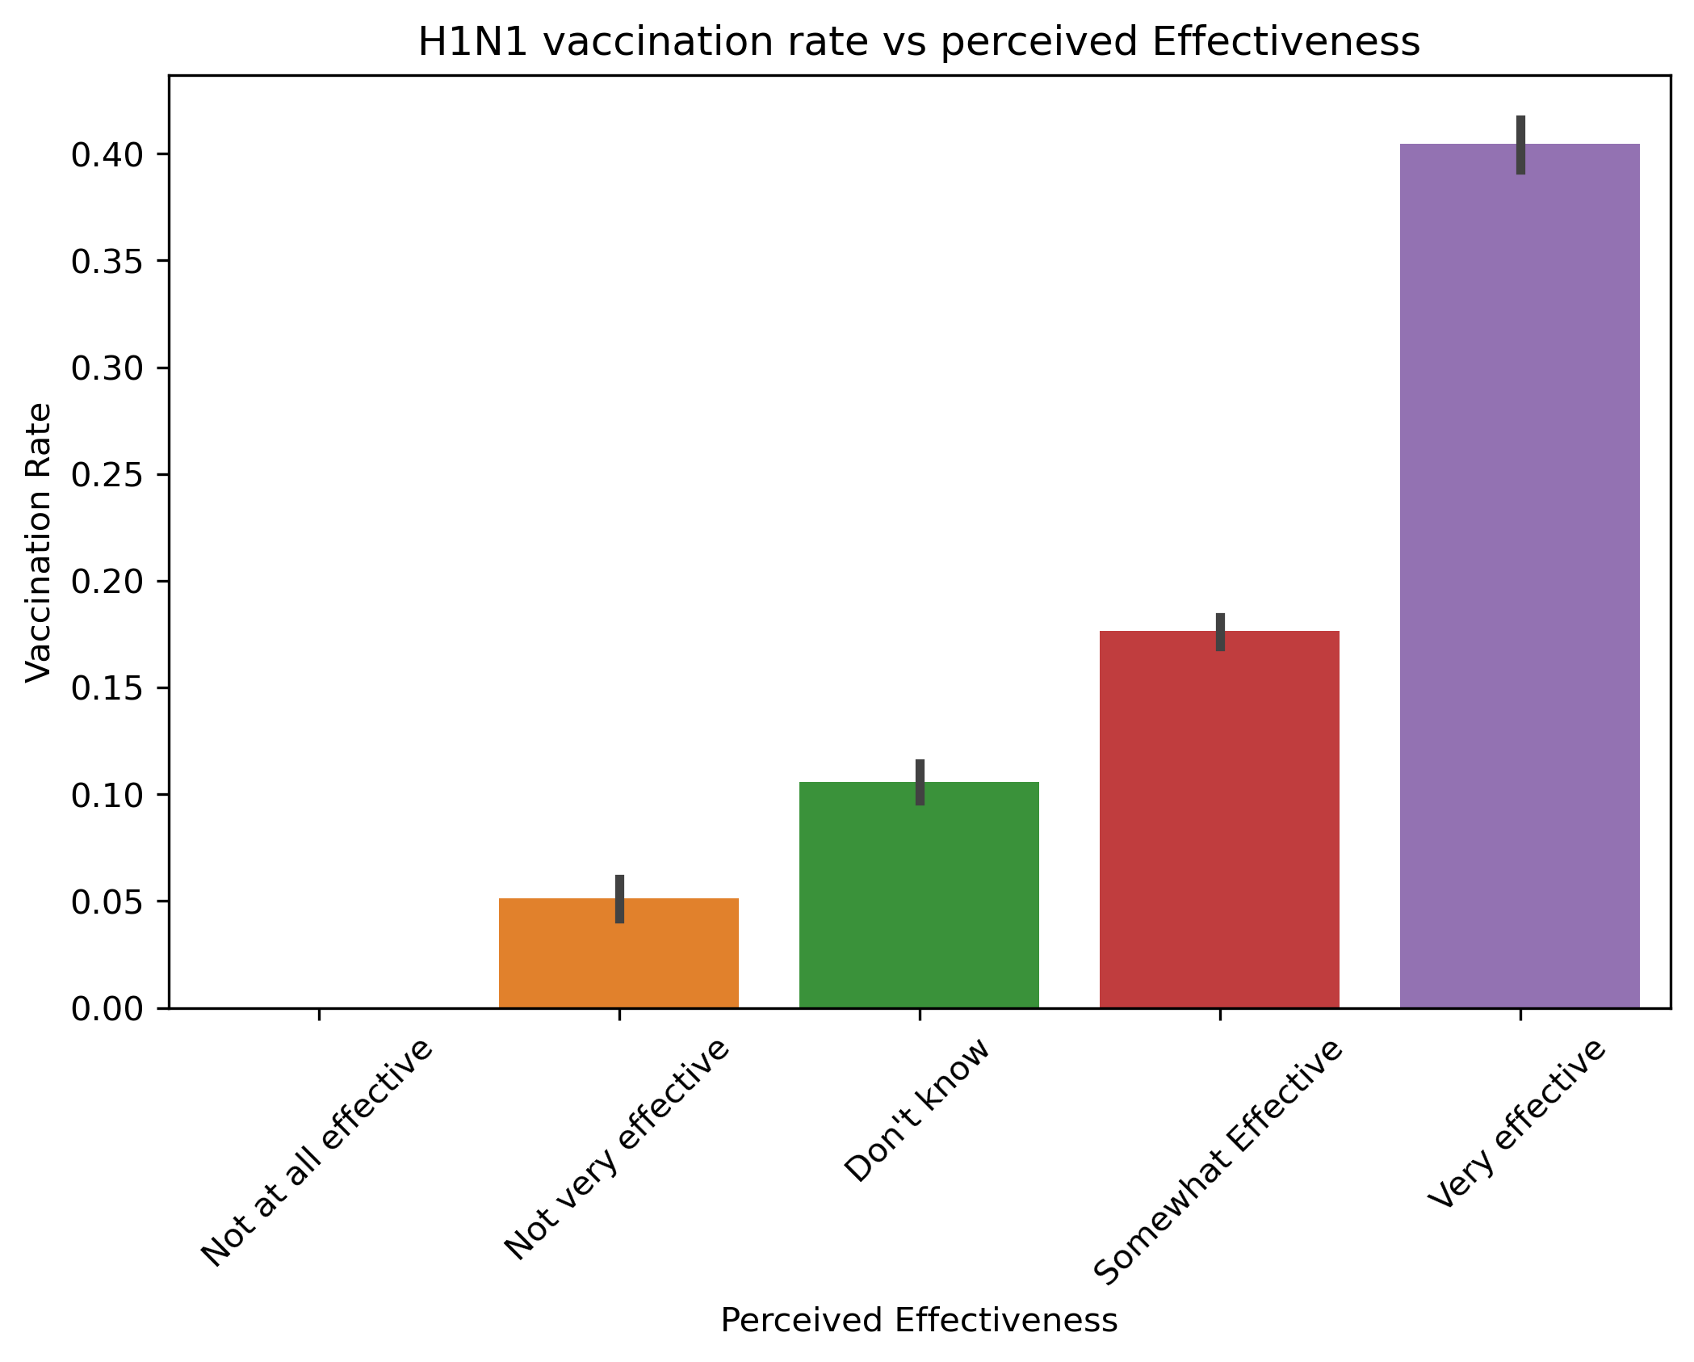
H1N1 Vaccine Effectiveness
About 44% of individuals belief in H1N1 vaccines’ effectiveness
More campaigns should be done to encourage more uptake as can be seen on the moderately large numbers of “Don’t Known” group

Slide 7
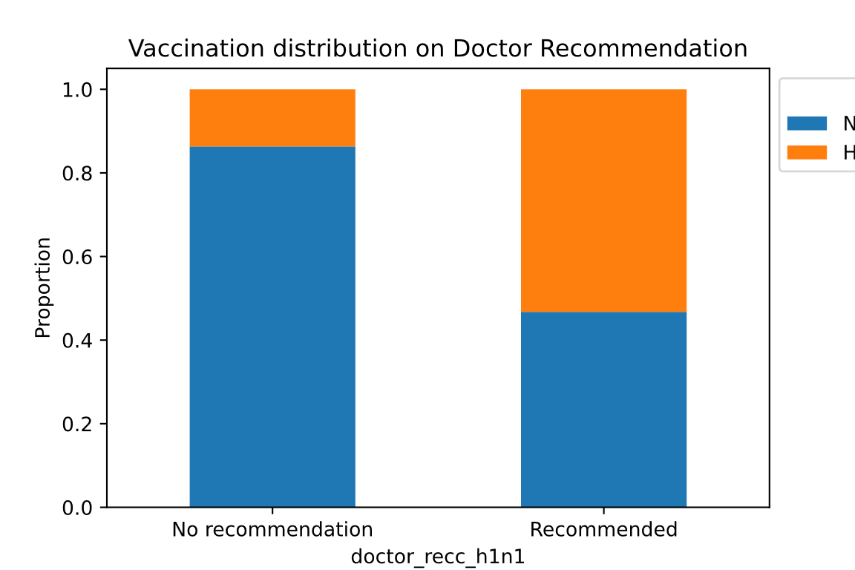
Doctor Recommendation on H1N1 Vaccine
Doctor’s recommendation has more influence in the vaccine uptake
Public health campaigns targeting doctor advice could substantially increase vaccine uptake

Slide 8
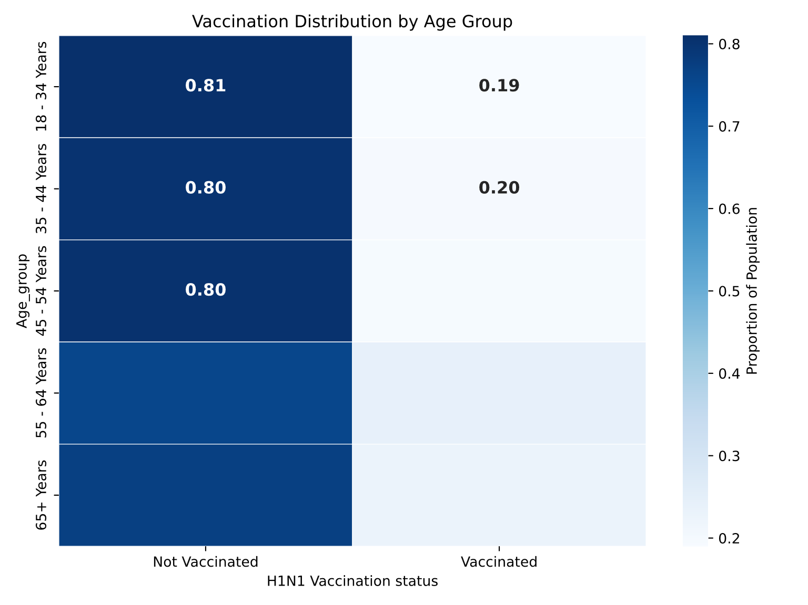
Age group Vs Vaccination distribution
Younger population don’t get vaccination and therefore should be the primary target for public health outreach

Slide 9
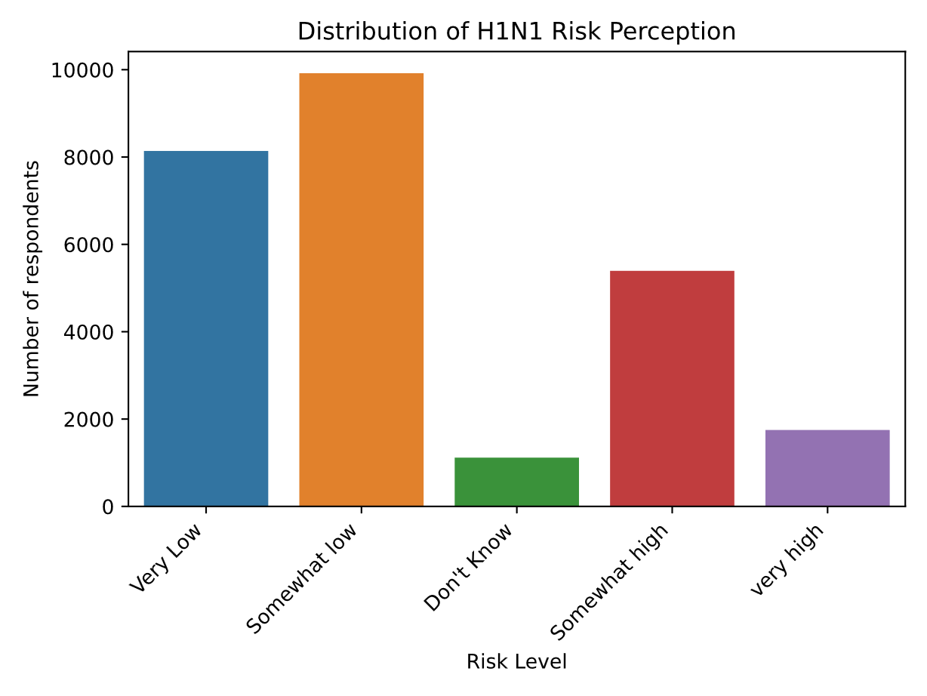
H1N1 Vaccine risk perception distribution
Most people does belief administration of H1N1 vaccines have low risk on their health.
Low percentages of individuals perceiving vaccine as low risk(about 67%) is still a barrier to convincing people to be vaccinated and could have informed on the low vaccination

Slide 10
Recommendation
Enhance educational awareness campaigns on vaccines
Use medical professionals to recommend vaccines
Use more robust predictive models

Slide 11
Next steps
Build more accurate models using other advanced machine learning modelling approaches
Get latest data on the H1N1 vaccines

Slide 12
Thank you
Contact:
Email: ronohcollins@gmail.com
Linkedin : www.linkedin.com/in/collins-ronoh-3392319
Github: https://github.com/ronohcollins/Phase_3_project

